Slide 1

Stage 6 Retaliation Is Swift! Course Designer: Ken Wang
Retaliation is swift! is a 20 round, 110 point Fixed Time Medium course. There are 10 IPSC targets. The best two hits per target will score. The start signal is audible. The par time is 9 seconds.
The Handgun start position is standing anywhere inside the shooting area with wrists below belt. Handgun loaded and holstered. The PCC start position is standing anywhere inside the shooting area, PCC loaded, stock on belt, safety on.
On the audible start signal, engage all targets from within the shooting area. The stomp pad activates S1 and S2. Both targets are visible at rest. The stomp pad is not a shooting area. Scoring notes: Failure to activate activator will incur FTSA & Miss penalties on activators not visible prior to activation

Slide 2
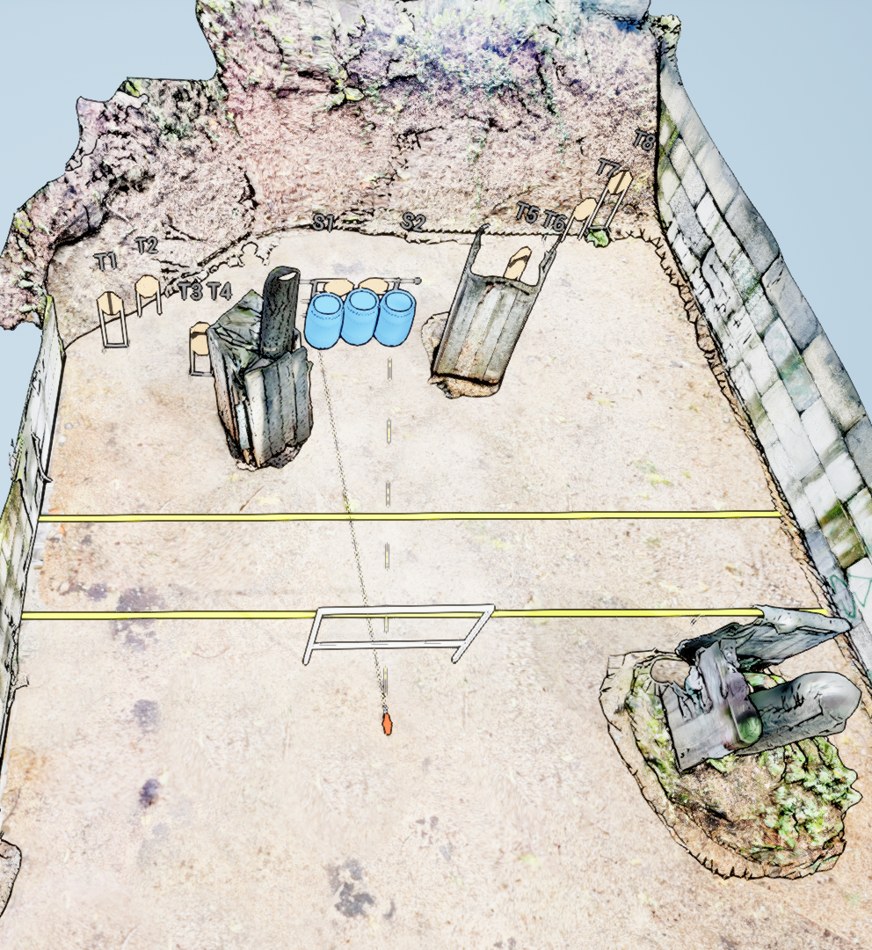
 | Stage 6 Retaliation Is Swift! Course Designer: Ken Wang

